Slide 1
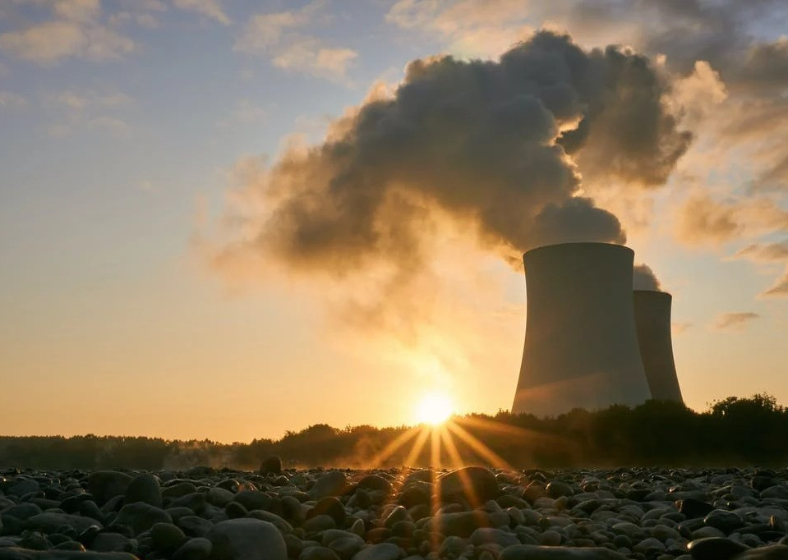
Nuclear Energy

Slide 2

What is nuclear energy?
Form of energy released from the nucleus
Fig 1: Nuclear power plant

Slide 3
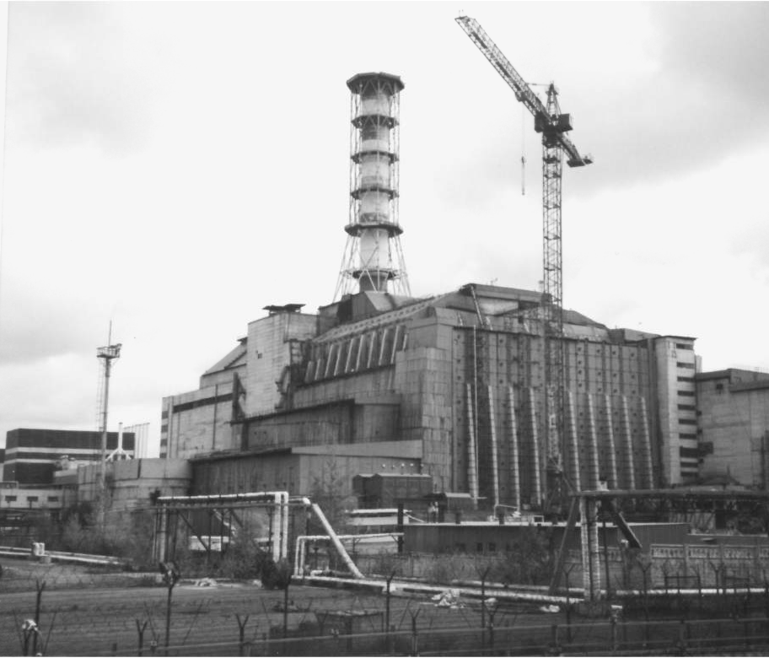
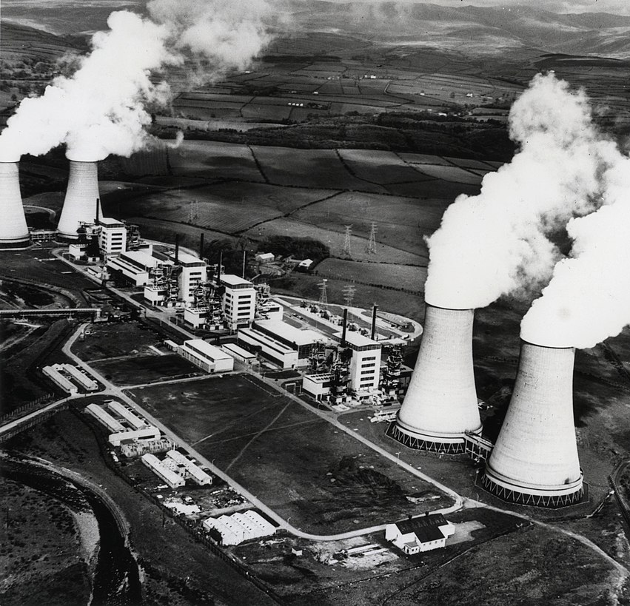
HISTORY:
Fig 2:
Chernobyl Reactor,Ukraine
Nuclear fission ----> First discovery ----> 1938
Chicago Pile-1 ----> First man-made nuclear reactor ----> December 2, 1942
USS Nautilus ----> First nuclear powered submarine ----> January 1954
Obninsk Nuclear Power Plant ----> First to generate electricity ----> June 27, 1954
Fig 3:Calder Hall Reactor,England

Slide 4
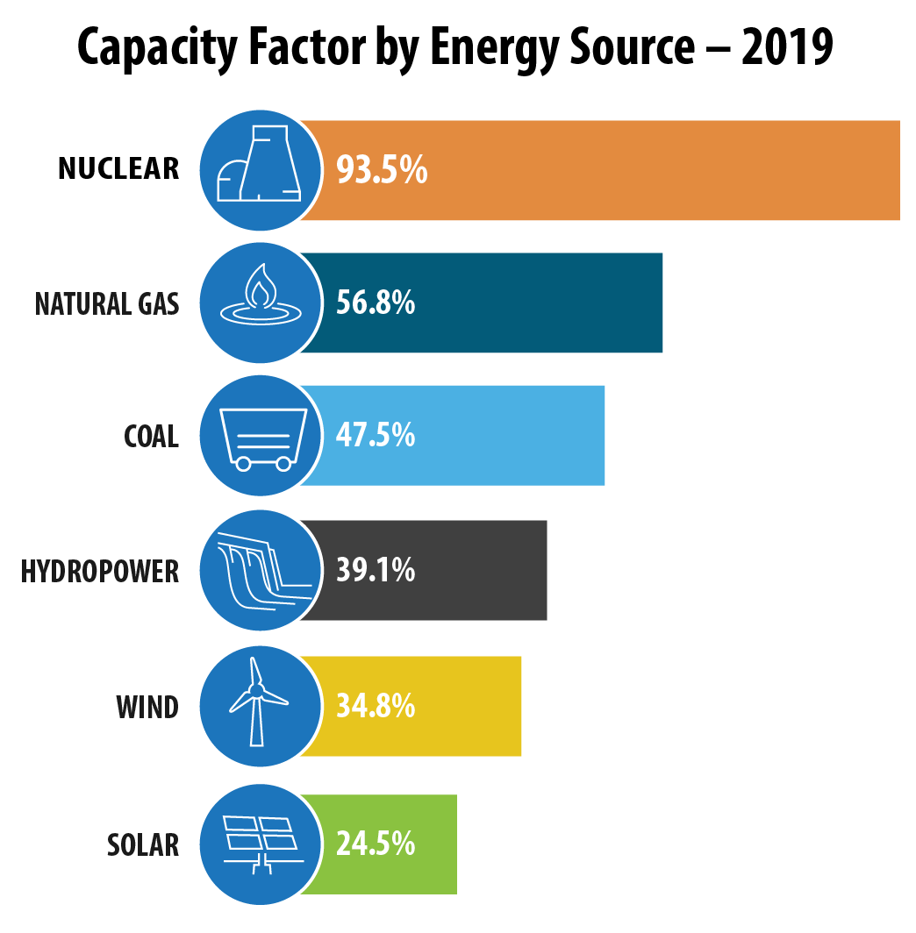
Why use?
Produce more !!ELECTRICITY!!
1 Uranium fuel pallet
=
1 Ton Coal
or
½ Ton Natural Gas
Fig 4: Capacity factor by energy source

Slide 5
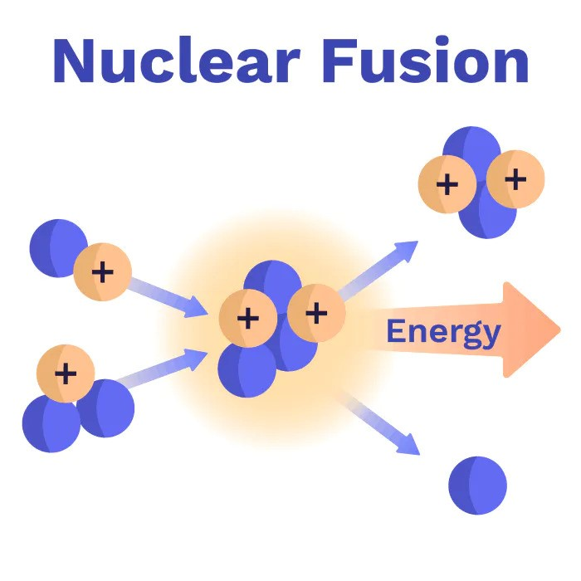
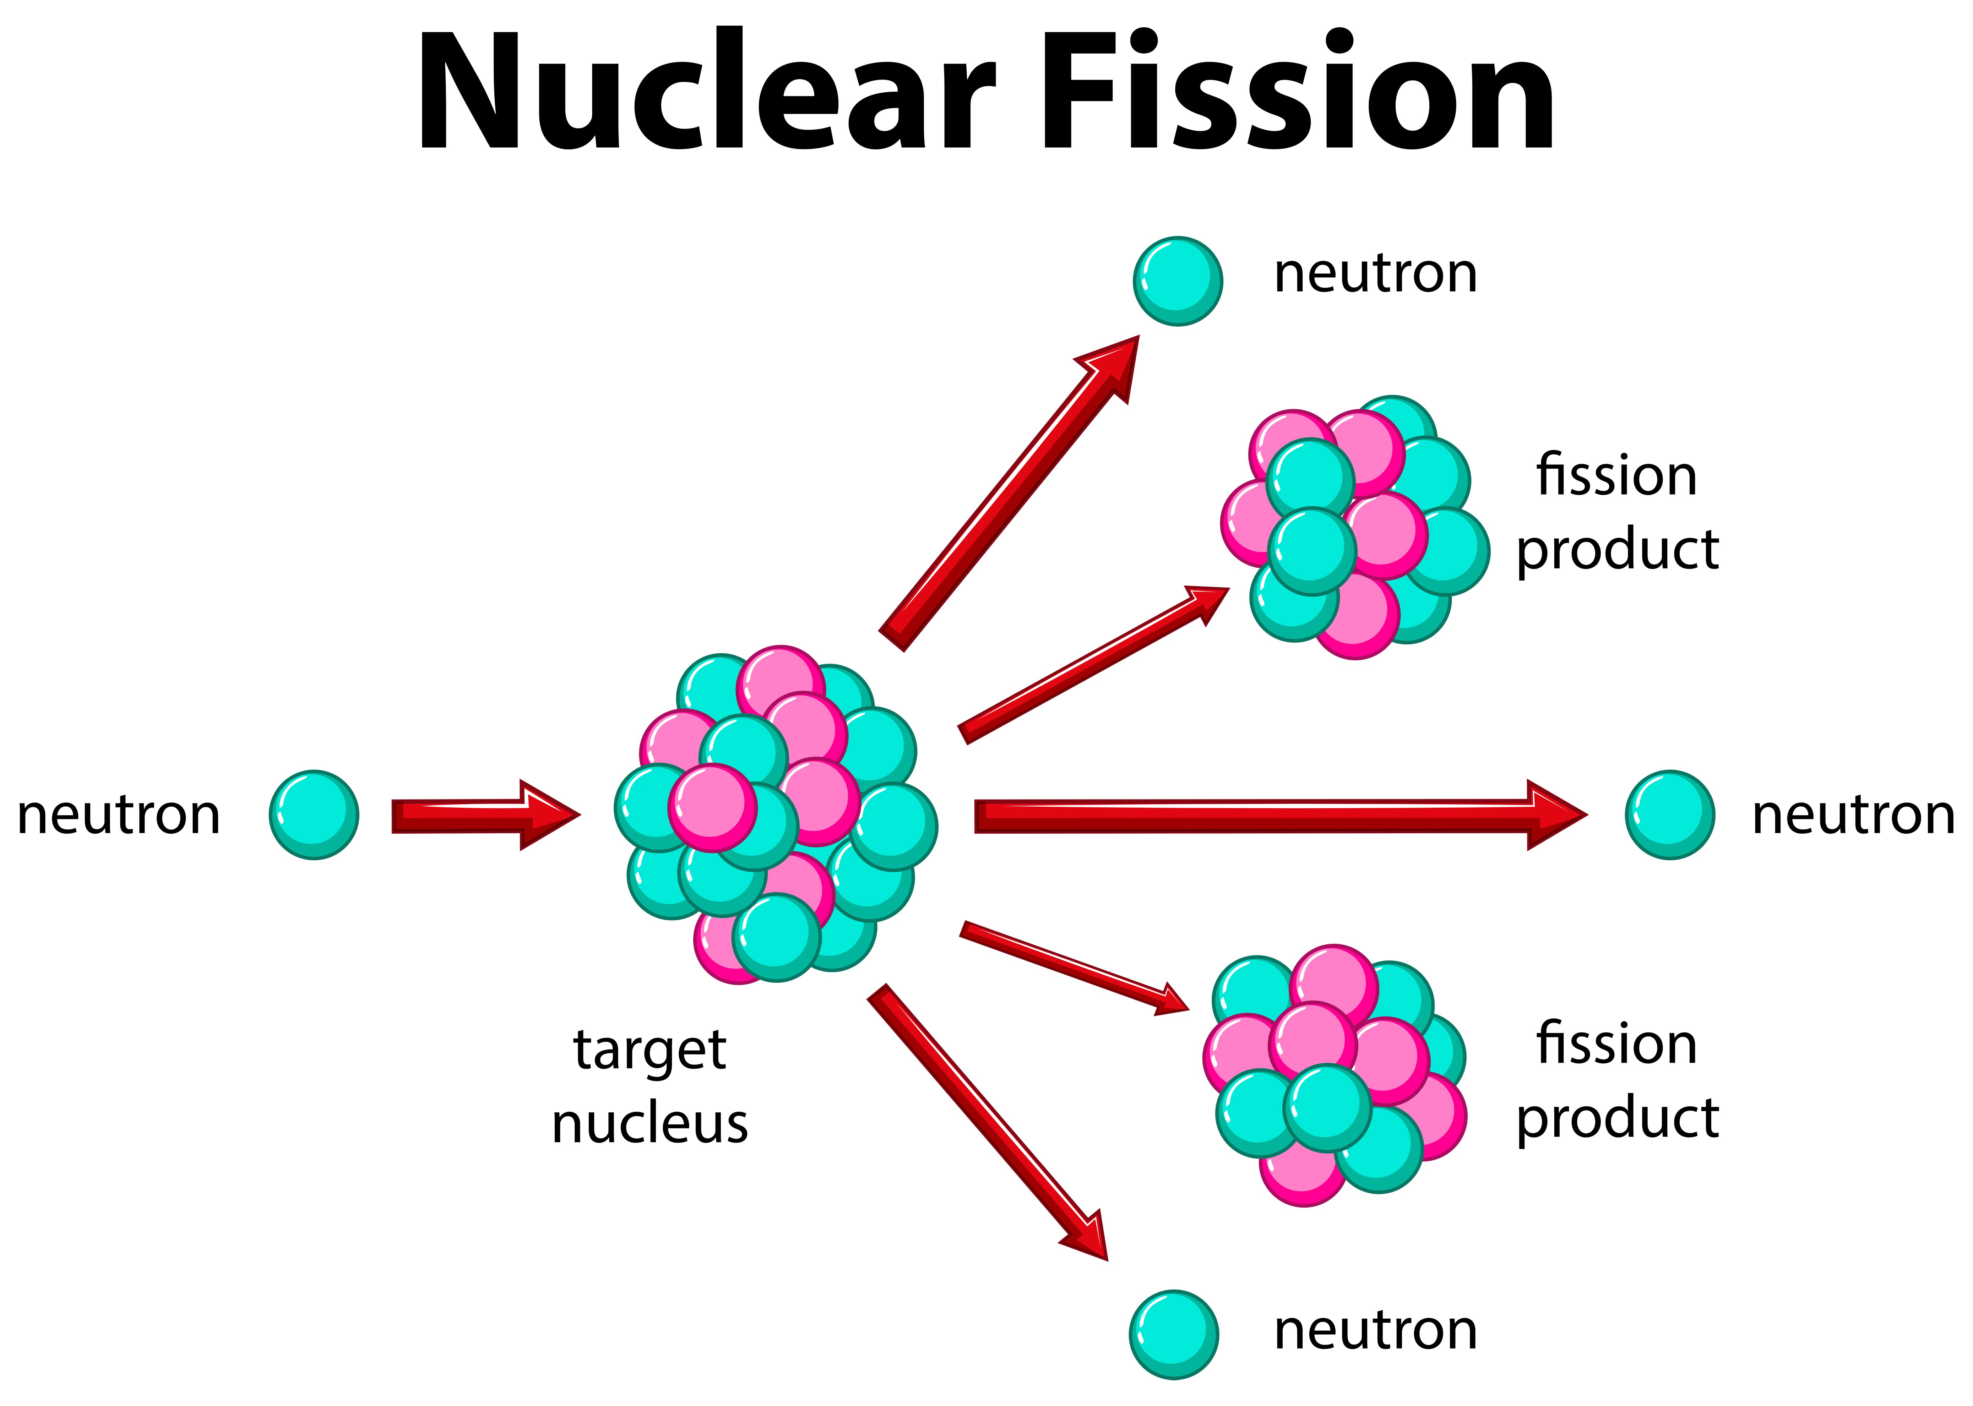
Ways:
Fig 5: Nuclear Fusion
Fig 6: Nuclear fission

Slide 6
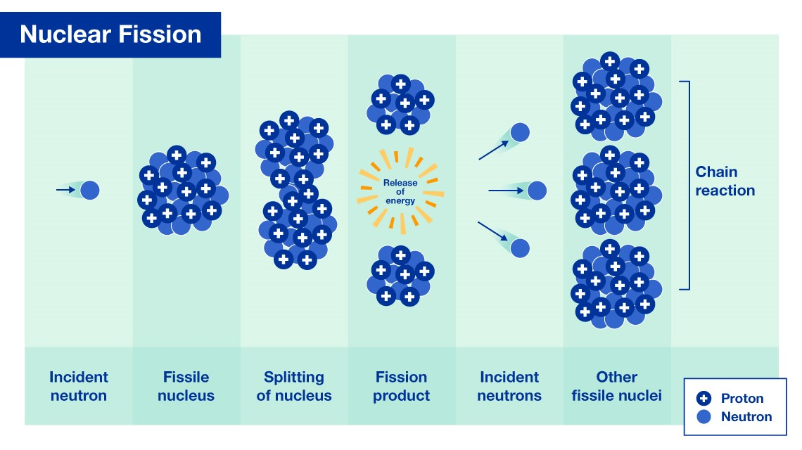
Fig 7: Nuclear fission principle

Slide 7
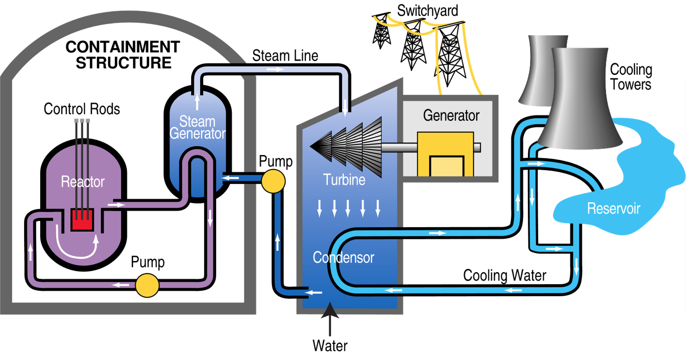
Fig 8: Pressurized water reactor

Slide 8

New horizon

Slide 9
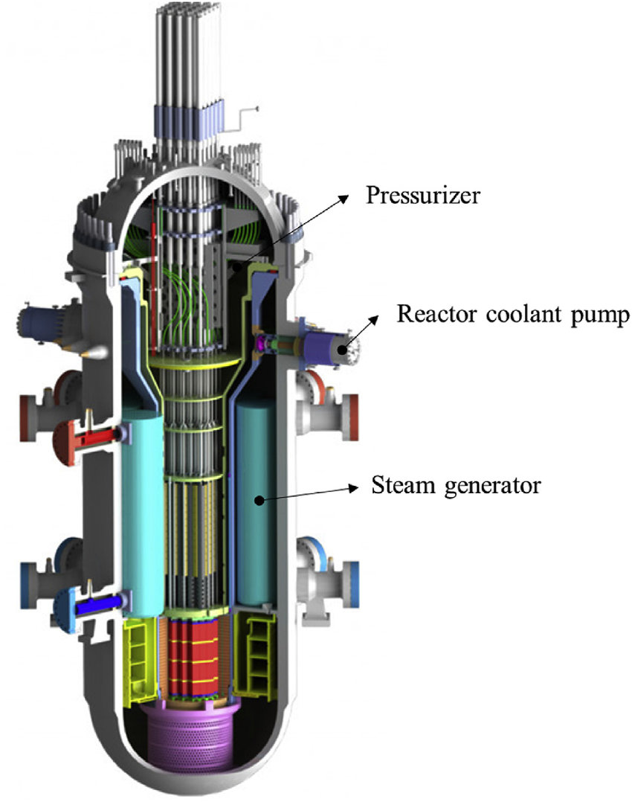
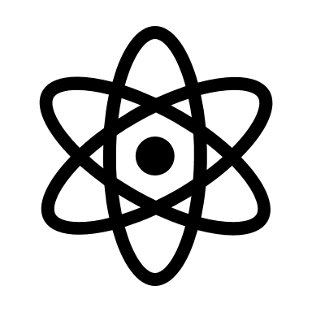
Small modular reactor:
These advanced reactors, envisioned to vary in size from tens of megawatts up to hundreds of megawatts, can be used for power generation, process heat, desalination, or other industrial uses.
Fig 9: SMR(small modular reactor)

Slide 10
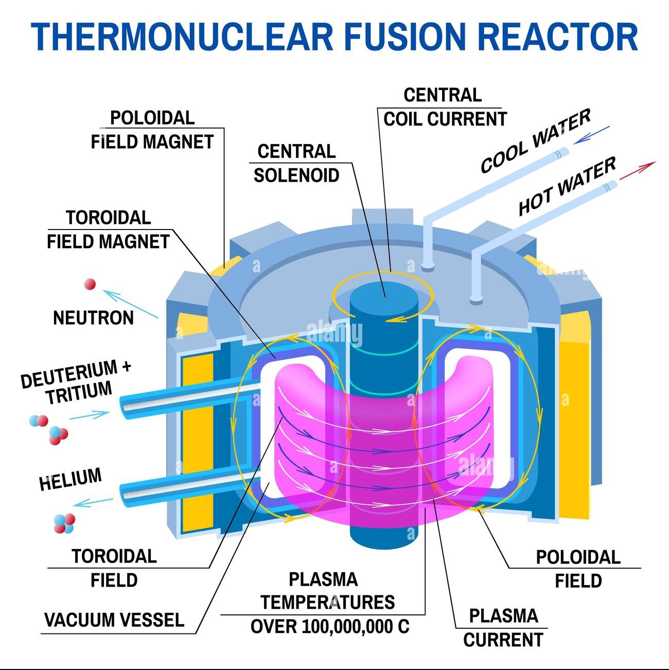

Fusion reactor:
The JET tokamak is the largest and most advanced magnetic fusion reactor currently operating. But the next generation of reactors is already in the works, most notably the ITER experiment, set to begin operations in 2027.
Fig 10: Nuclear fusion reactor

Slide 11

Economics

Slide 12
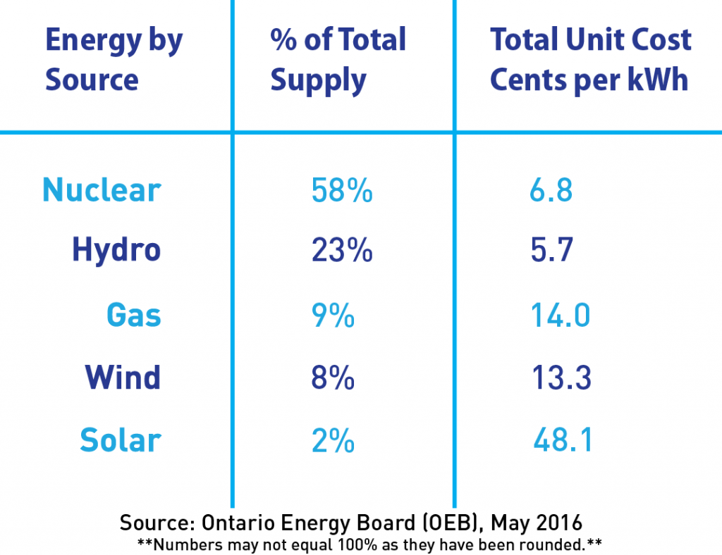
Fig 11: Total supply and unit cost per kWh

Slide 13
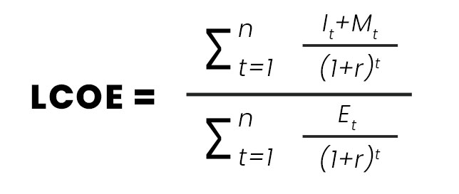
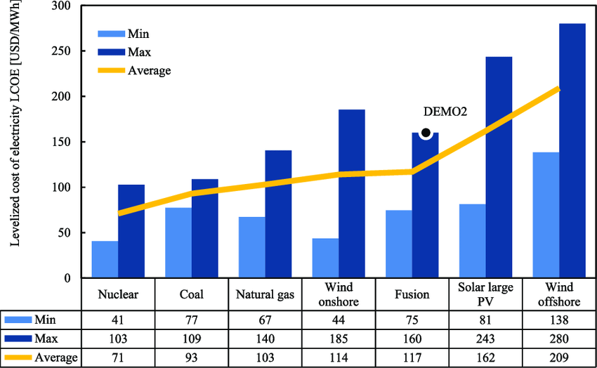
Fig 22: LCOE of different sources

Slide 14
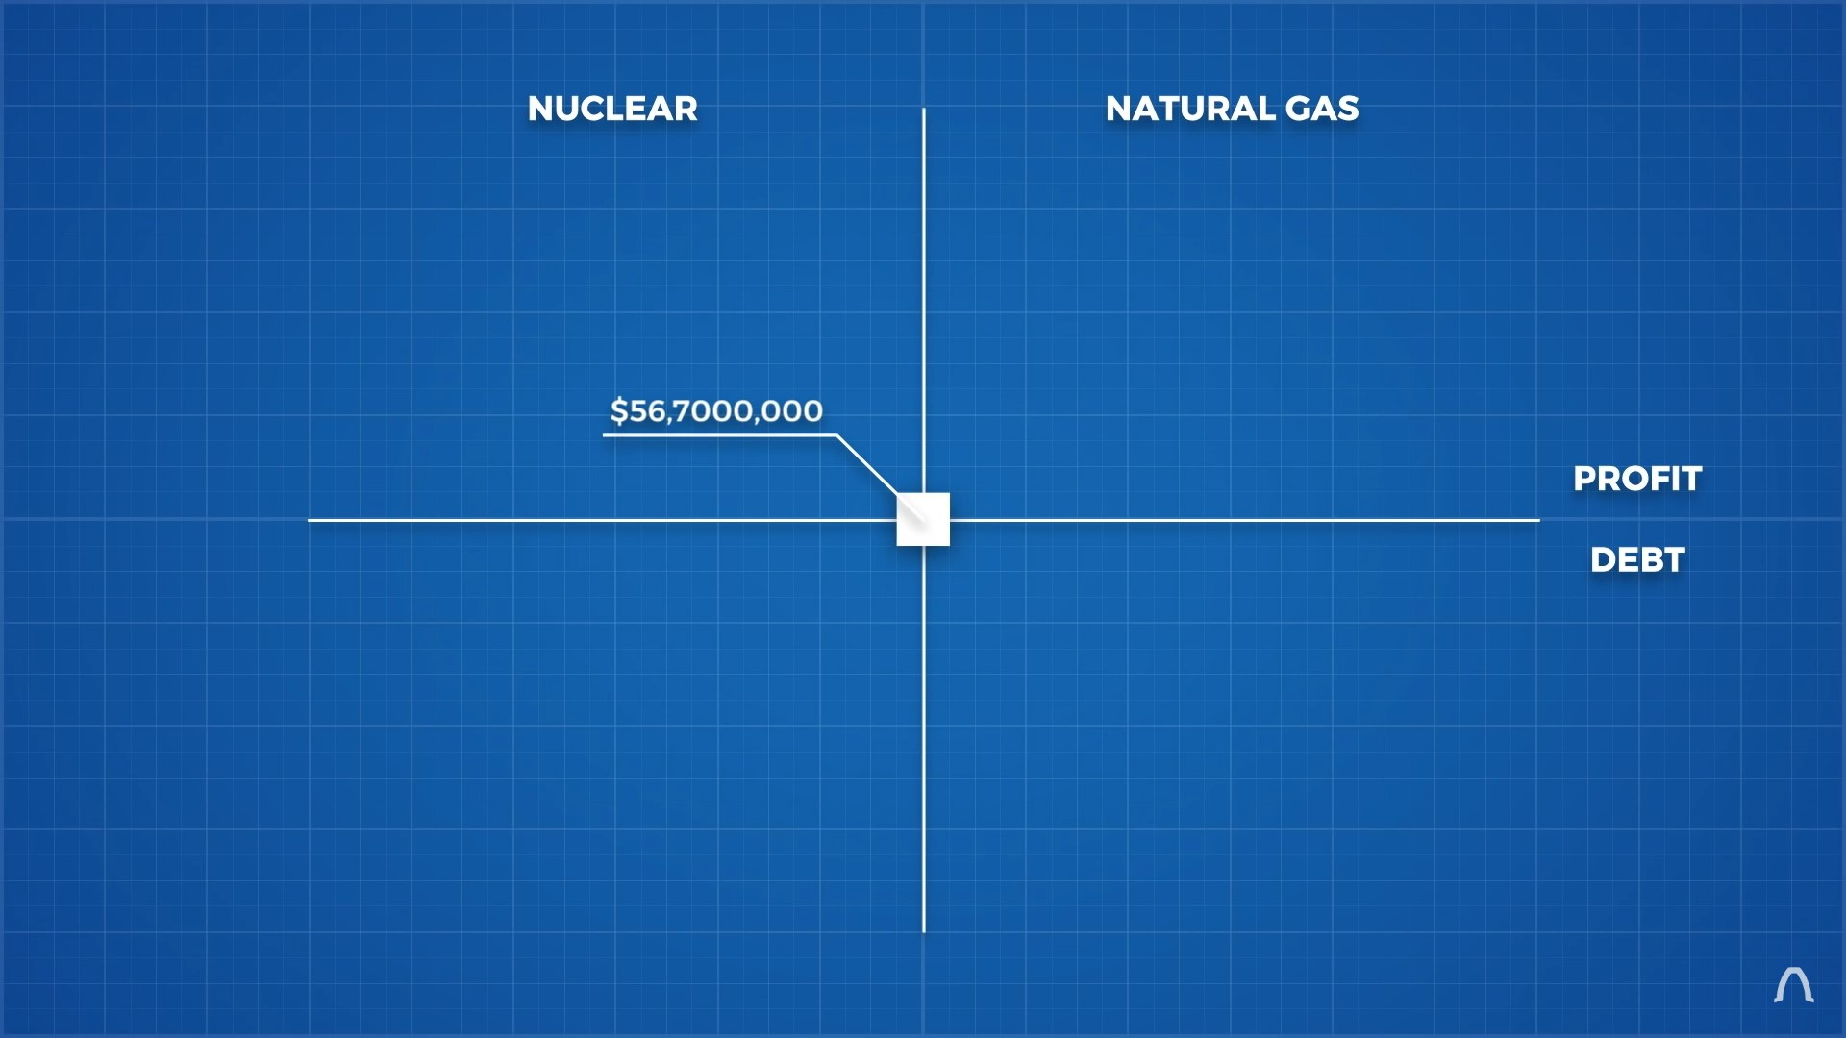
Is it profitable?
Keep in mind:
1 block = $56.7 M
1GW = $64 M
Upper region = Profit
Lower region = Debt
Left region = Nuclear (N)
Right region = Natural Gas (NG)
Nuclear reactor construction = 6 years
Natural Gas plant construction = 2 years
Repayment plan = $1B (3% interest rate, 25 years) = $56.7M per year

Slide 15
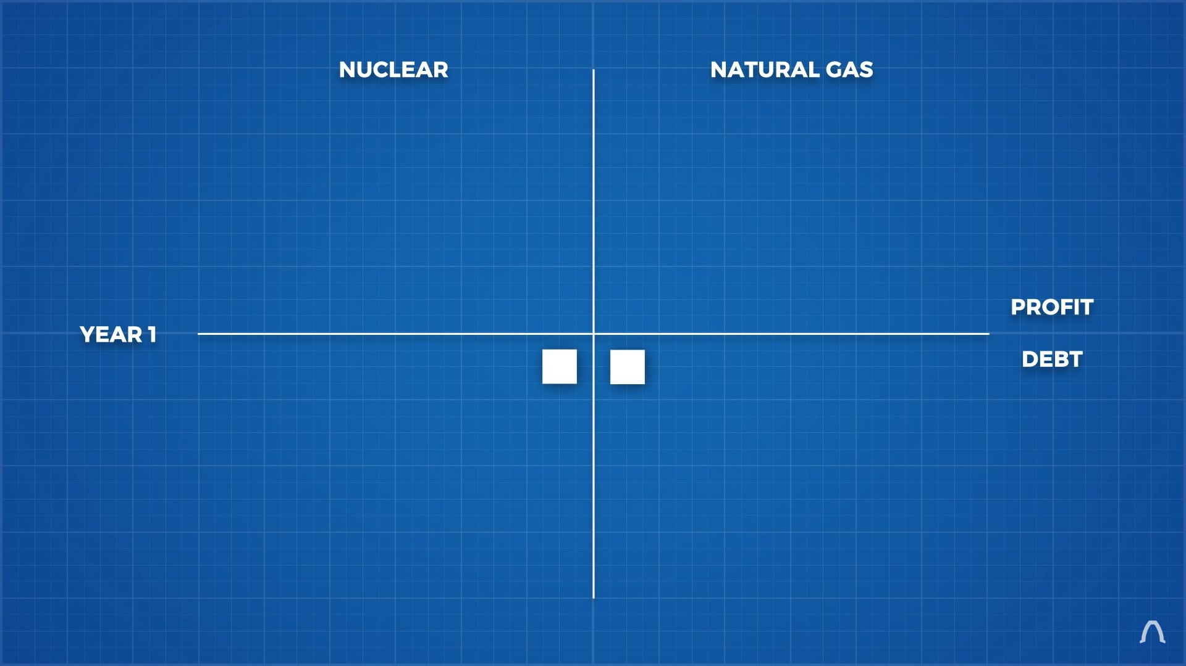
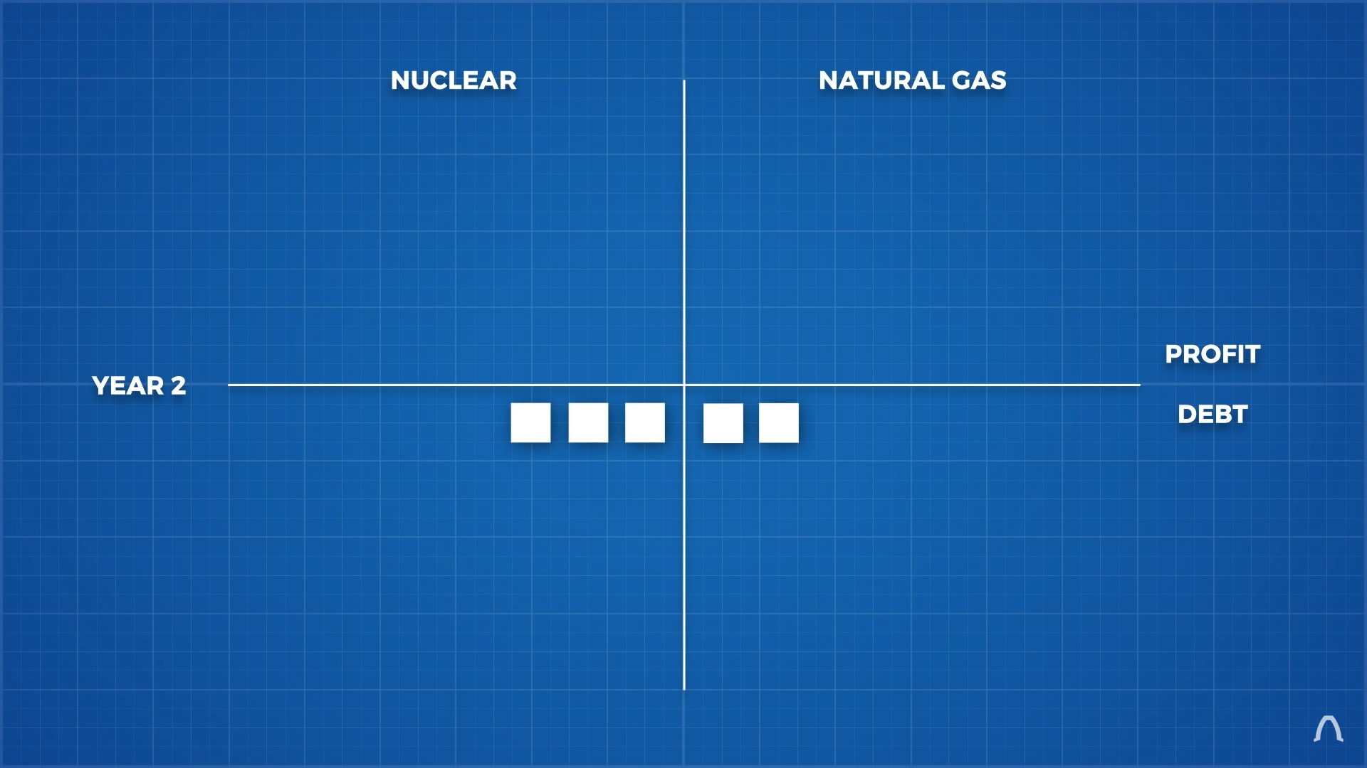
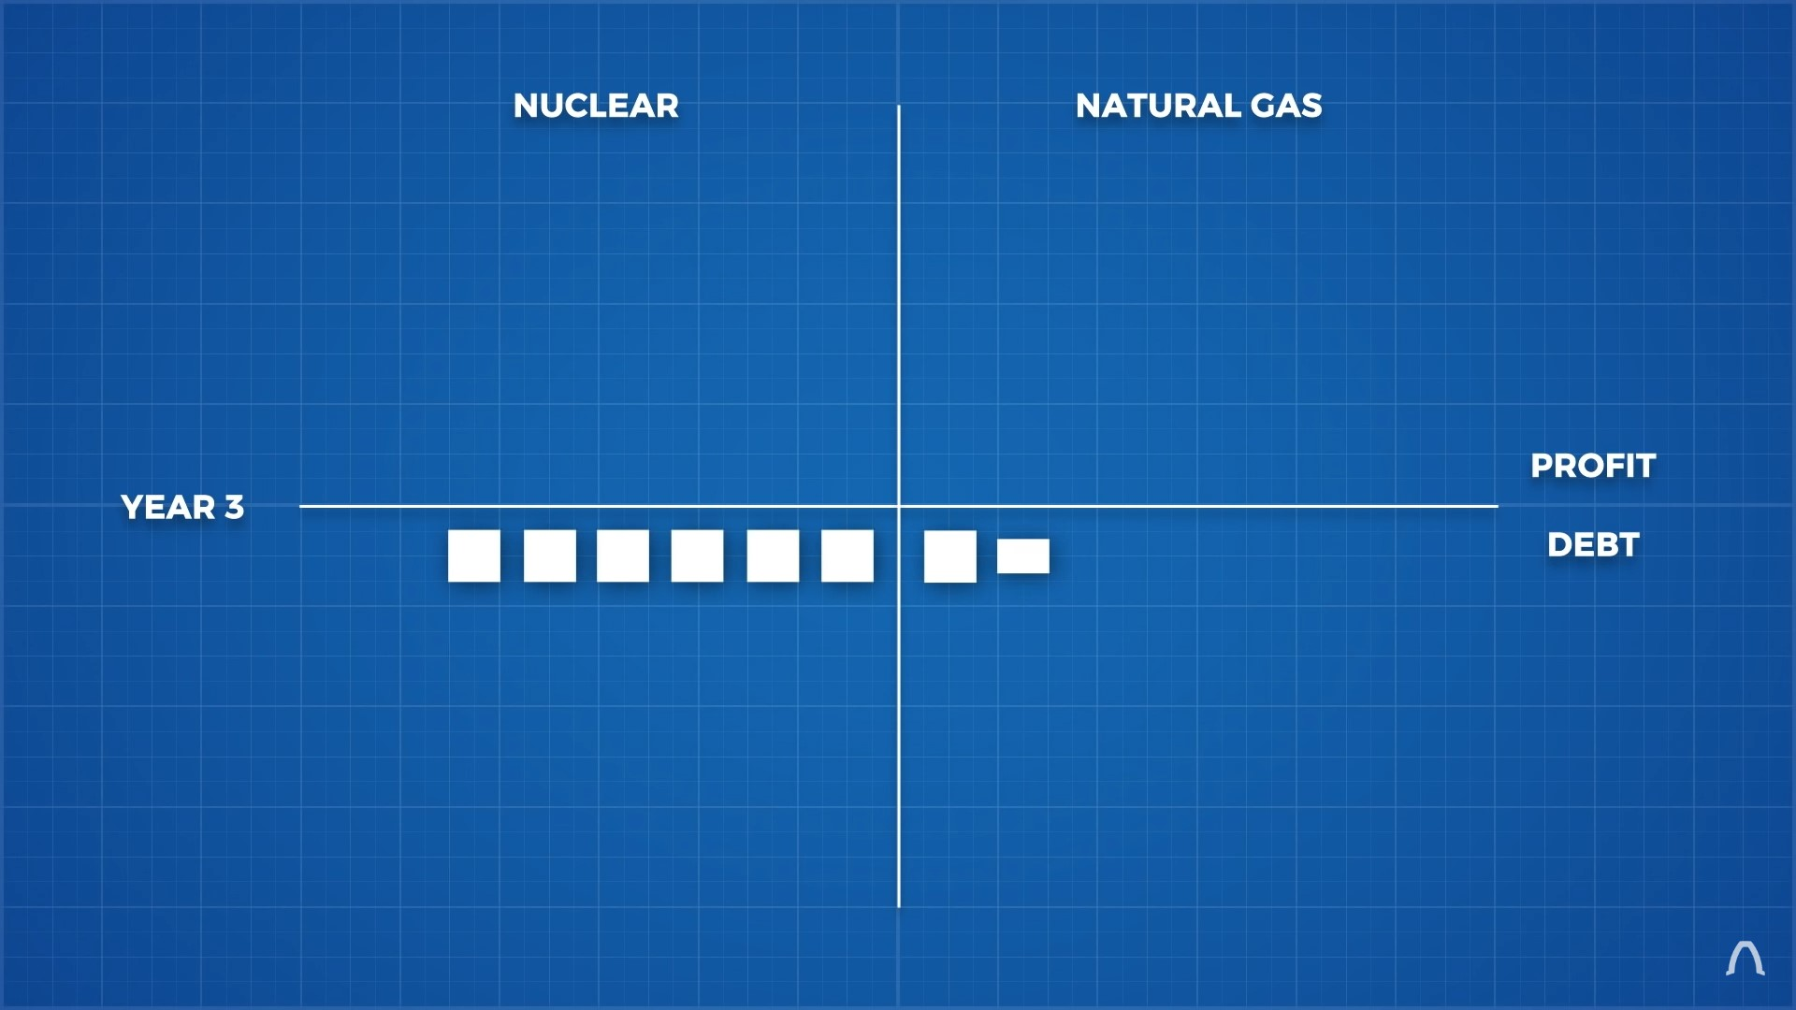
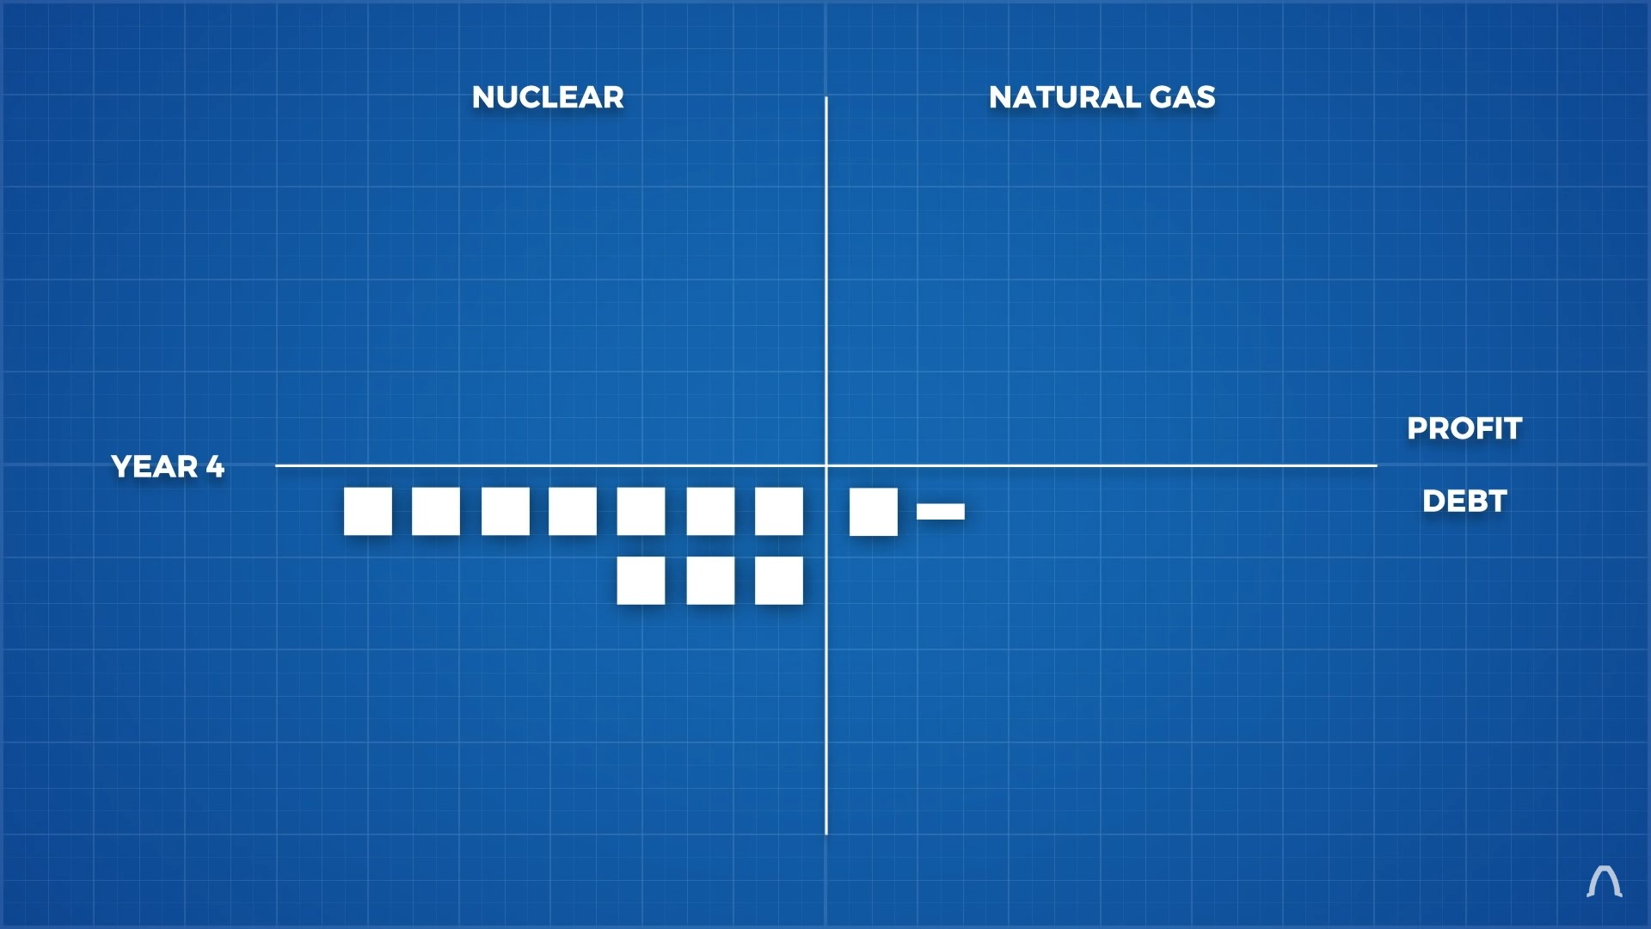
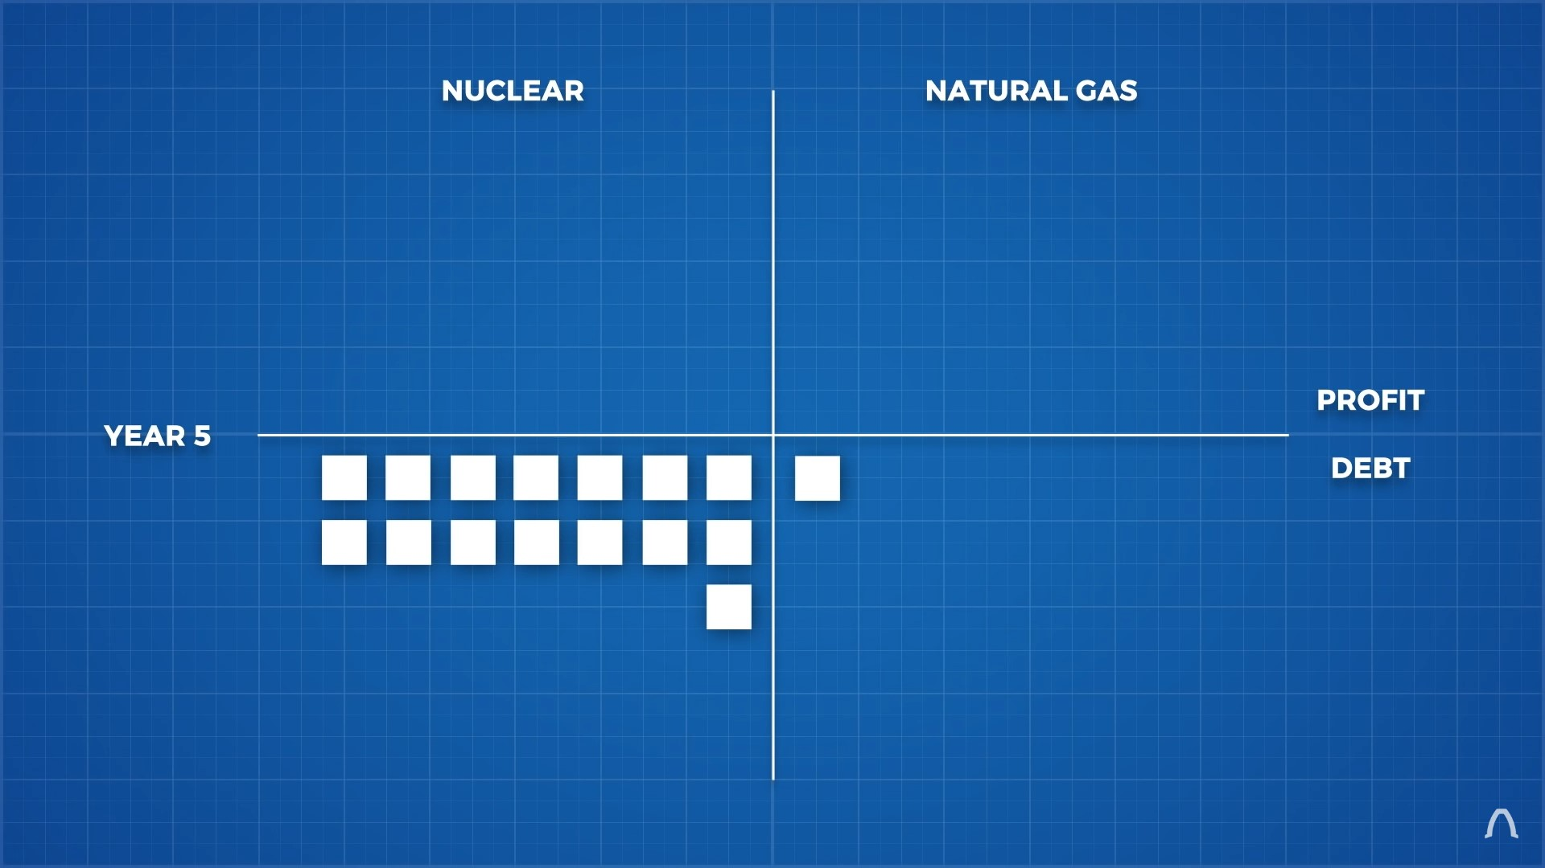
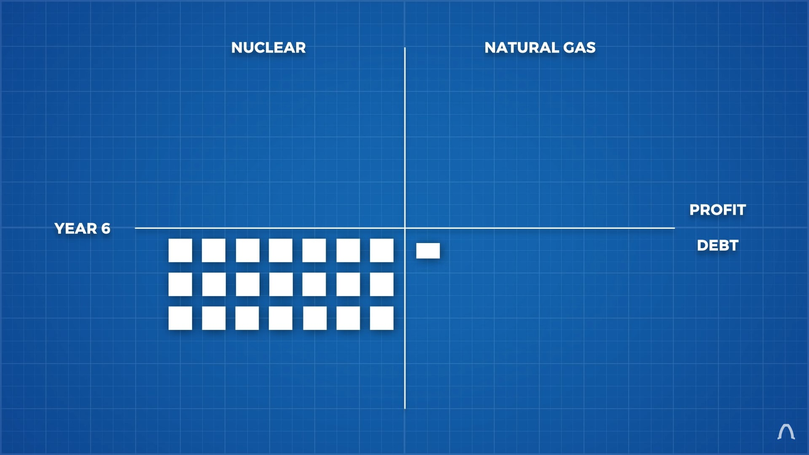
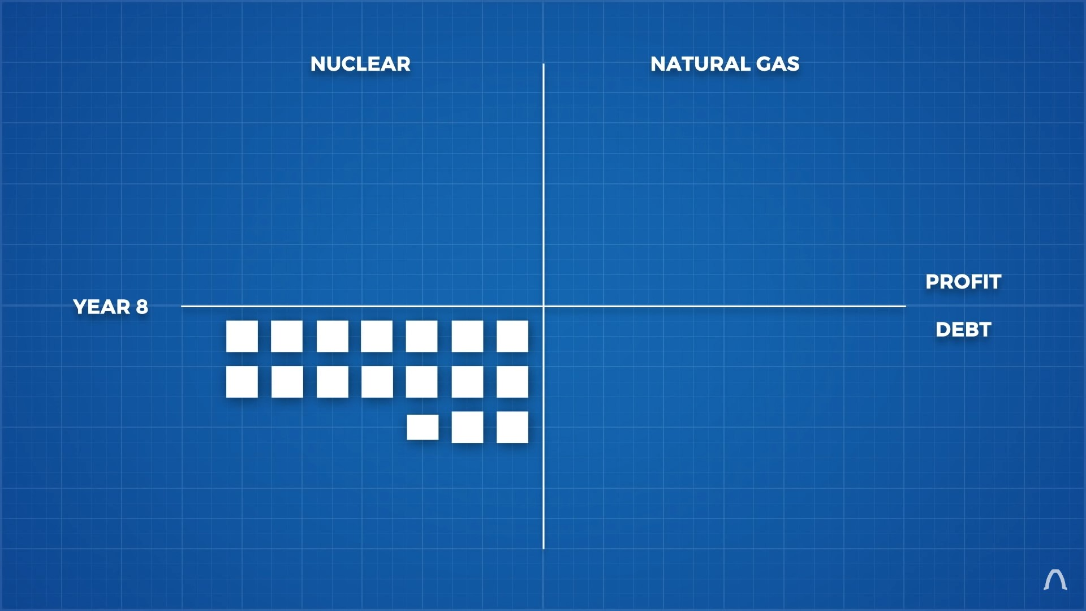
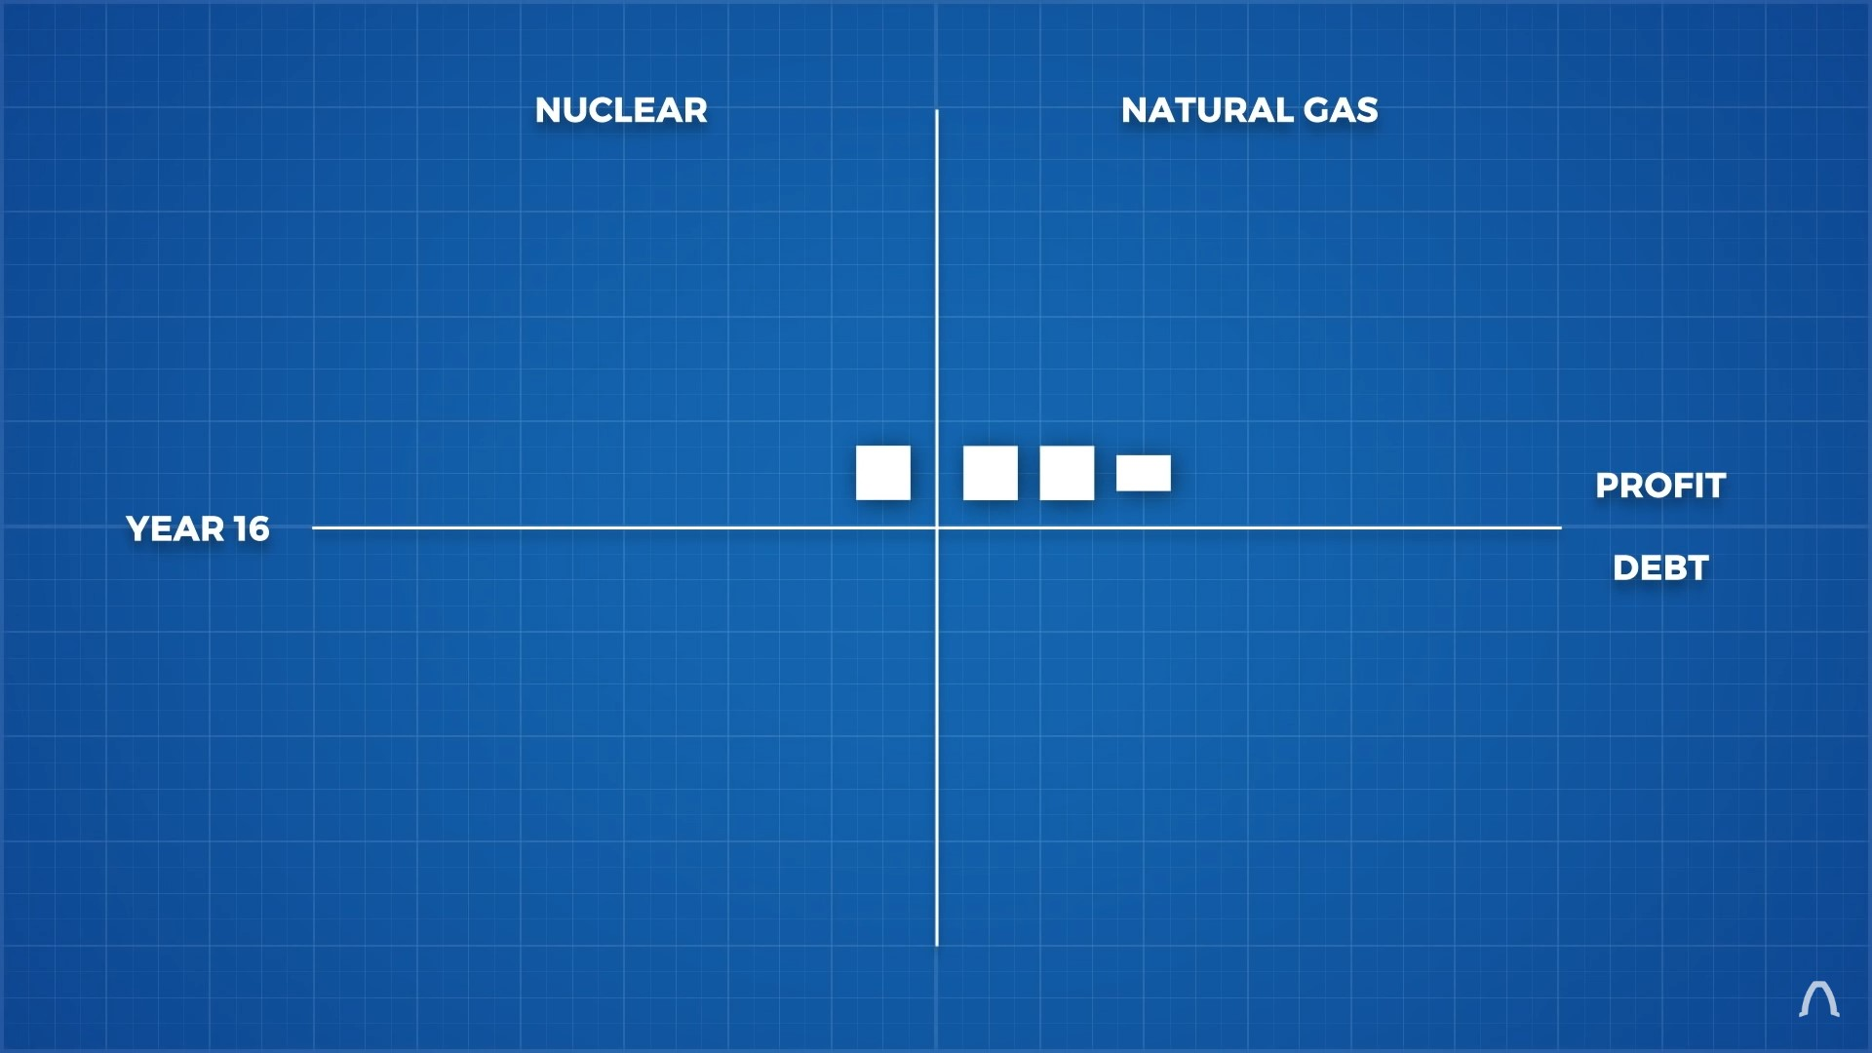
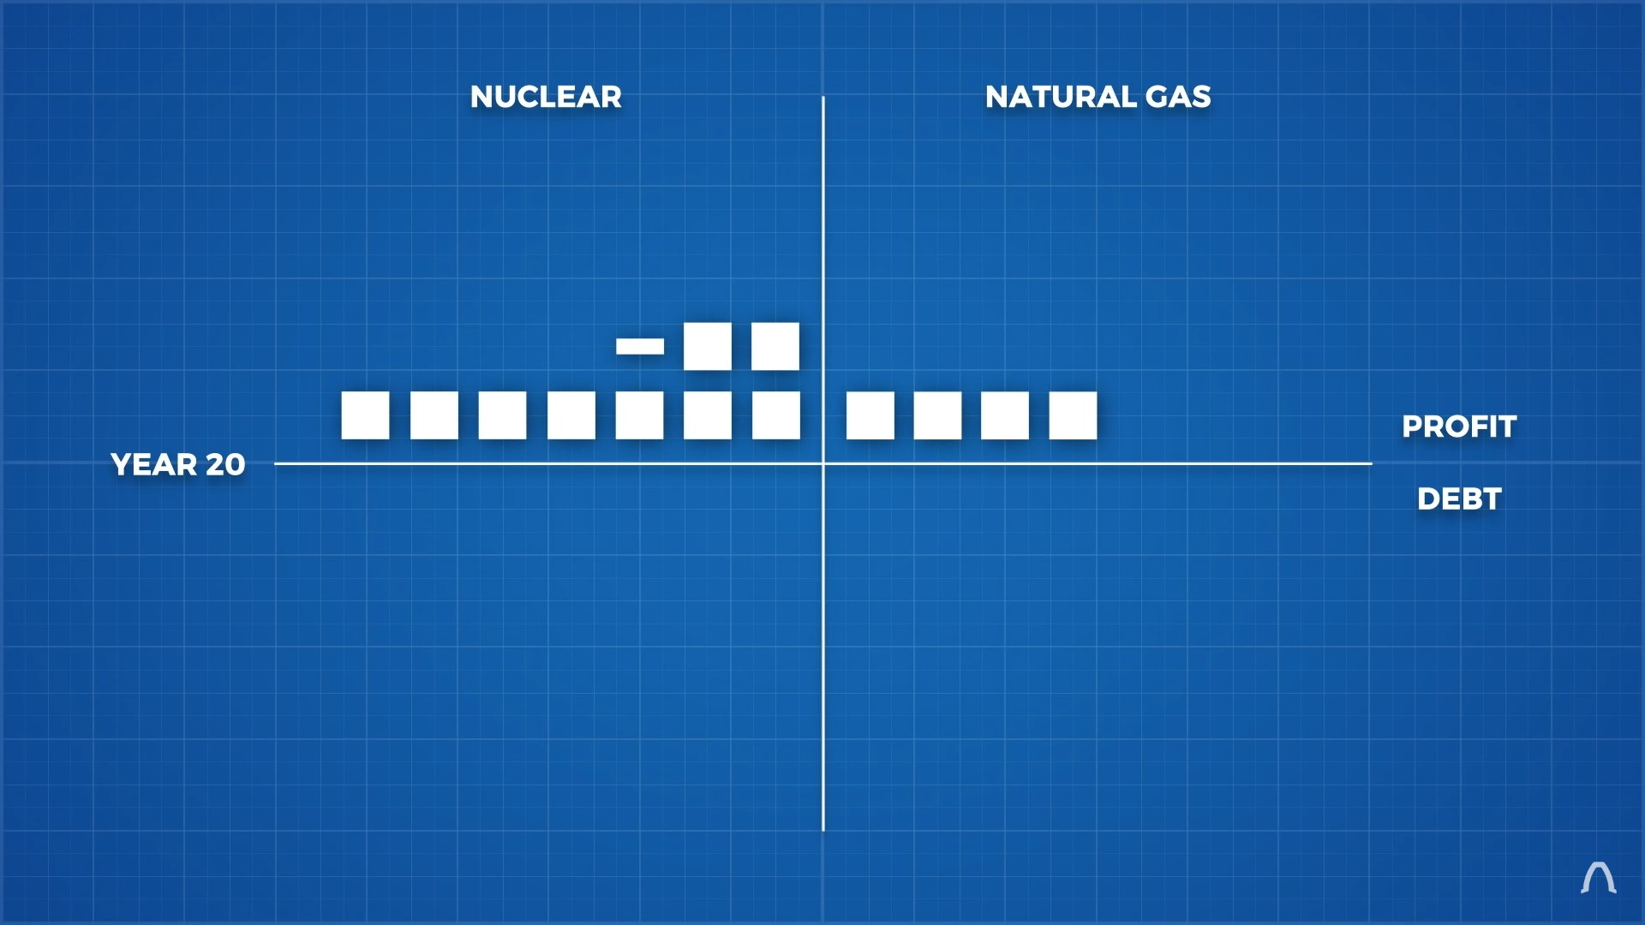
Year 1
Year 2
Year 3
Year 4
Year 5
Year 6
Year 8, NG(BE)
Year 16, Nuclear(BE)
Year 20 and so on...

Slide 16
Biggest question!! Is it safe?

Slide 17
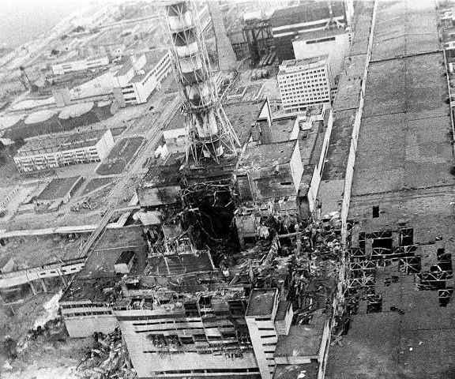
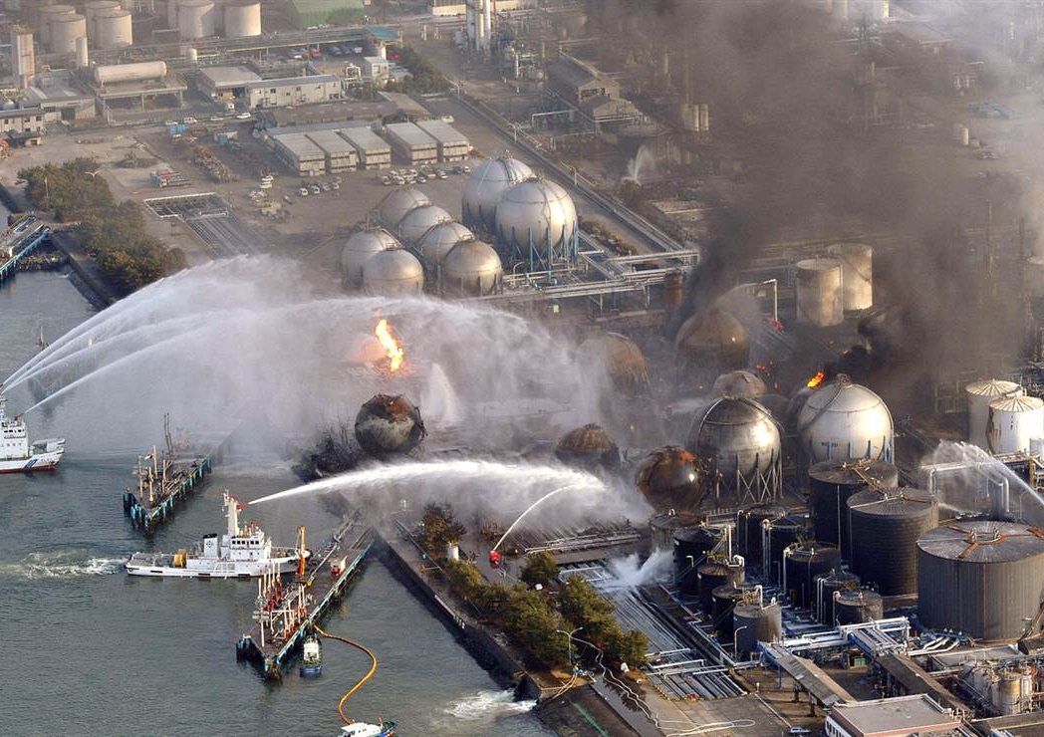
Naturally caused disaster
Fig 14: Fukushima nuclear disaster
Fig 13: Chernobyl nuclear disaster
Human fault disaster

Slide 18
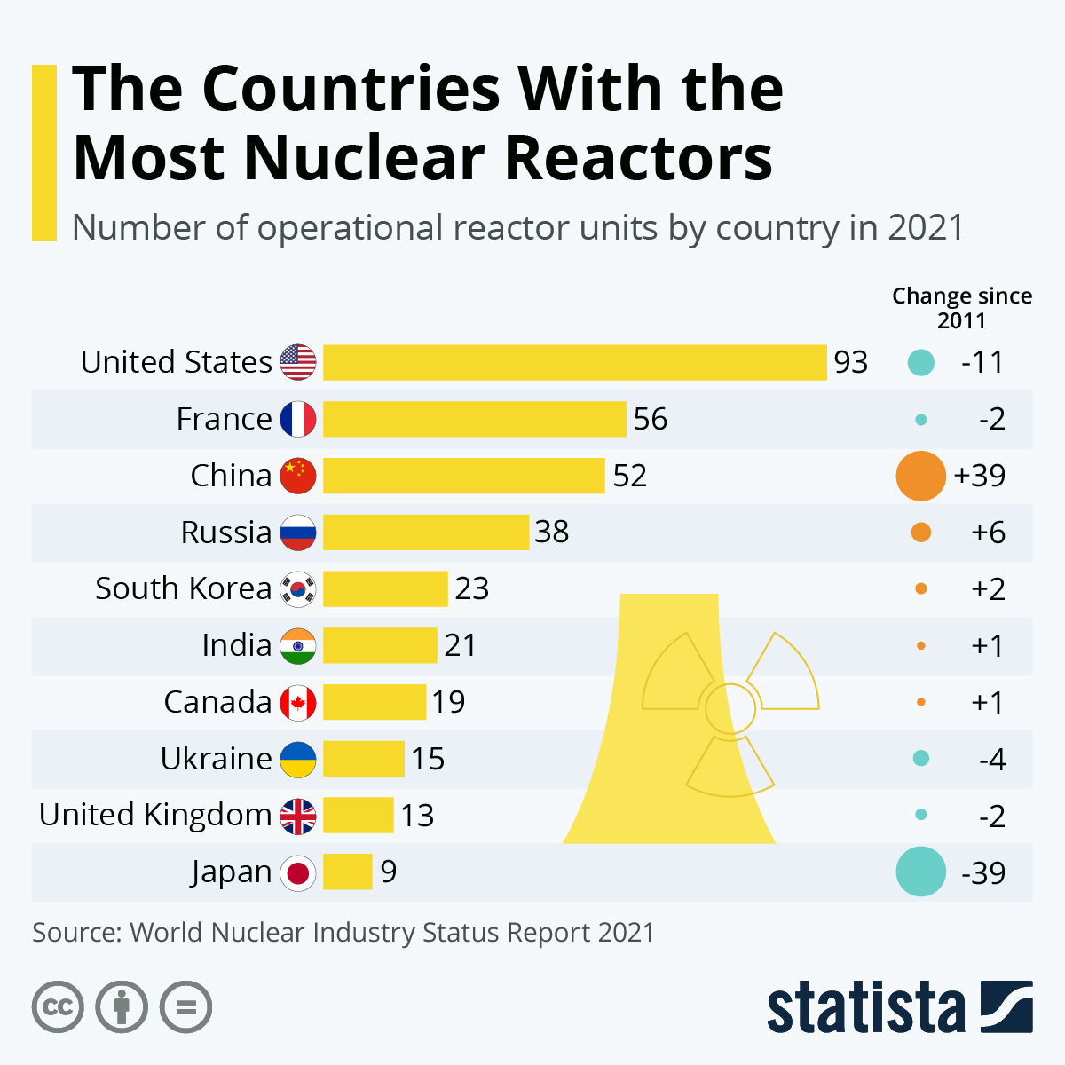
450 nuclear reactors in operation
53 are in construction
Fig 15: Nuclear reactors in operartion

Slide 19
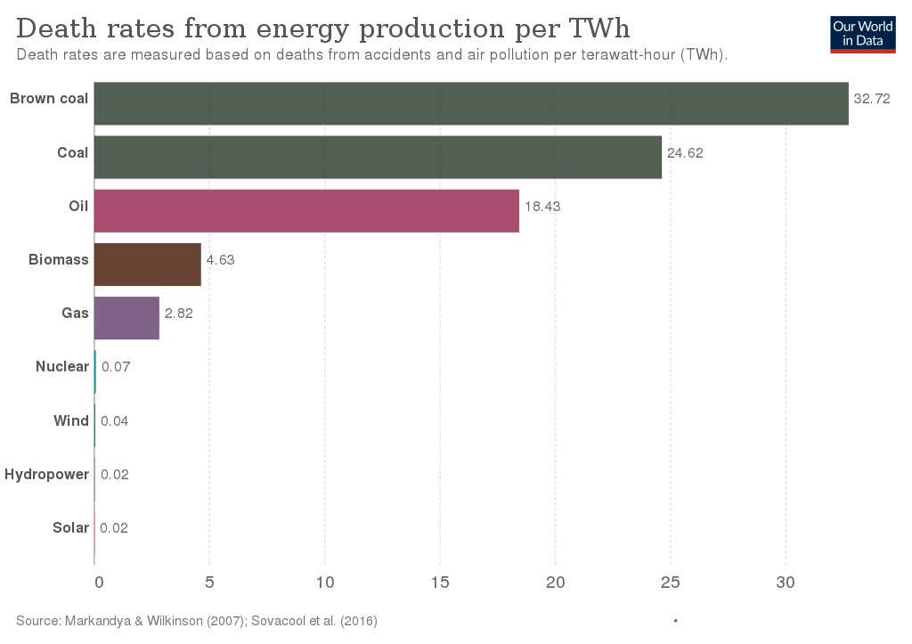
Fig 16: Death rates per TWh

Slide 20
Silver Lining

Slide 21
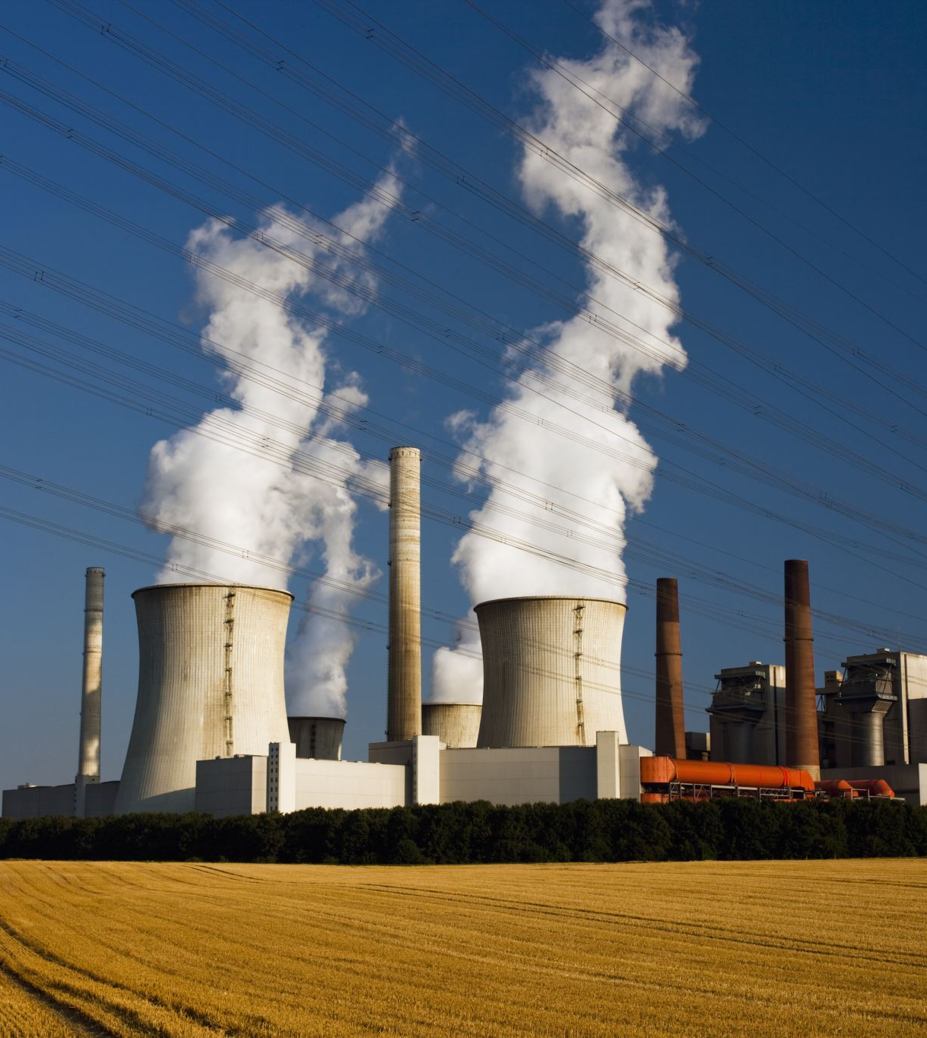
Load Shedding Crisis
Sustainable Energy Resource
Concerns and Uncertai nties
Upcoming future

Slide 22
References
[1] S. Chu, and A. Majumdar, "Opportunities and Challenges for a Sustainable Energy Future," Nature 488, 294 (2012), http://large.stanford.edu/courses/2016/ph241/lsm1/docs/wea-2000.pdf
[2] "DOE explains Nuclear Fusion reactions", https://www.energy.gov/science/doe-explainsnuclear-fusion-reactions?, (2022)
[3] R. Sims, H.-H. Roger, and K. Gregory, Carbon Emission and Mitigation Cost Comparisons Between Fossil Fuel, Nuclear and Renewable Energy Resources Electricity Generation," Energy Policy 31, 1315 (2003).
[4] Entler, Slavomir, et al. “Approximation of the Economy of Fusion Energy.” Energy, vol. 152, June 2018, pp. 489–497, www.sciencedirect.com/science/article/pii/S0360544218305395, 10.1016/j.energy.2018.03.130. Accessed 14 Apr. 2019.
[5] Anness, Michael, et al. "SMR Activities, Progress, Challenges-Panel." Nuclear Science and Engineering (2022).
[6] Liguori, Gio. "In Order to Combat Climate Change, The United States Must Look to Expand its Global Nuclear Infrastructure."

Slide 23
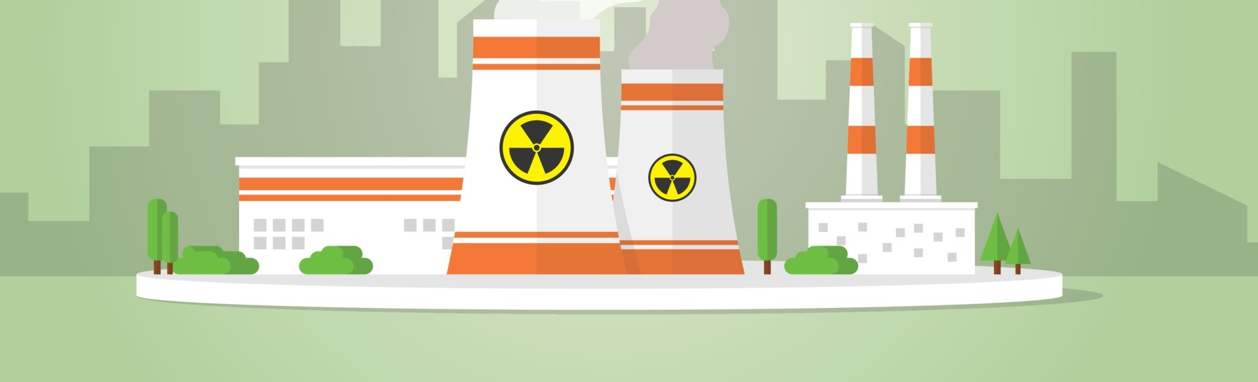
Thank you
"Nuclear power is one hell of a way to boil water." --
Albert Einstein

Slide 24

Any questions?

